Slide 1
Regression
Chapter 16

Slide 2
Regression
Builds on Correlation
The difference is a question of prediction versus relation
Regression predicts, correlation describes relations

Slide 3
Simple Linear Regression
A statistical tool that lets us predict an individual’s score on the DV based on the score on one IV
Multiple linear regression uses more than one IV

Slide 4
The Equation for a Line
a = Intercept: predicted value of Y when X is equal to 0
Mean of Y
b = Slope: the amount that Y is predicted to increase for an increase of 1 in X

Slide 5
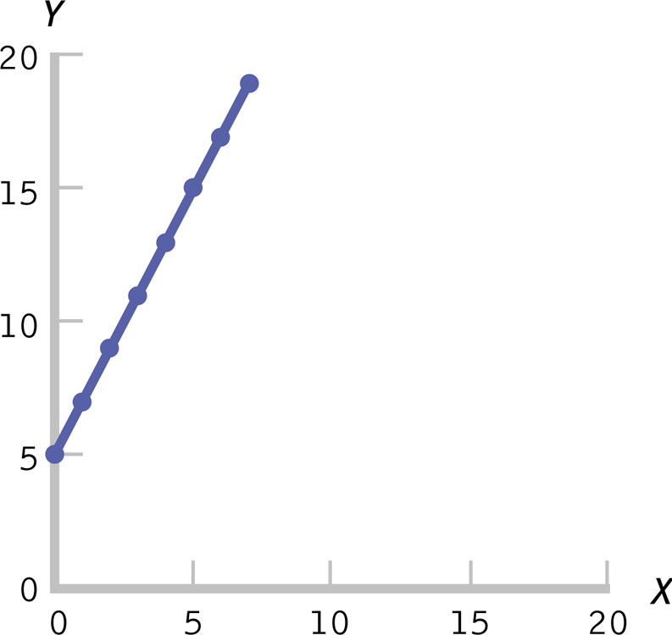
The Equation for a Line

Slide 6
Standardized regression coefficient
Statisticians love to standardize things.
Beta = standardized coefficient
It’s a z score of the slope value
WHY? Comparisons.
Beta = r with ONE predictor!

Slide 7
Assumptions of Data - Step 1
Random selection?
X and Y at least scale variables?
Linear relationship between variables? (linearity)
Outliers?
*find these the same as correlation

Slide 8
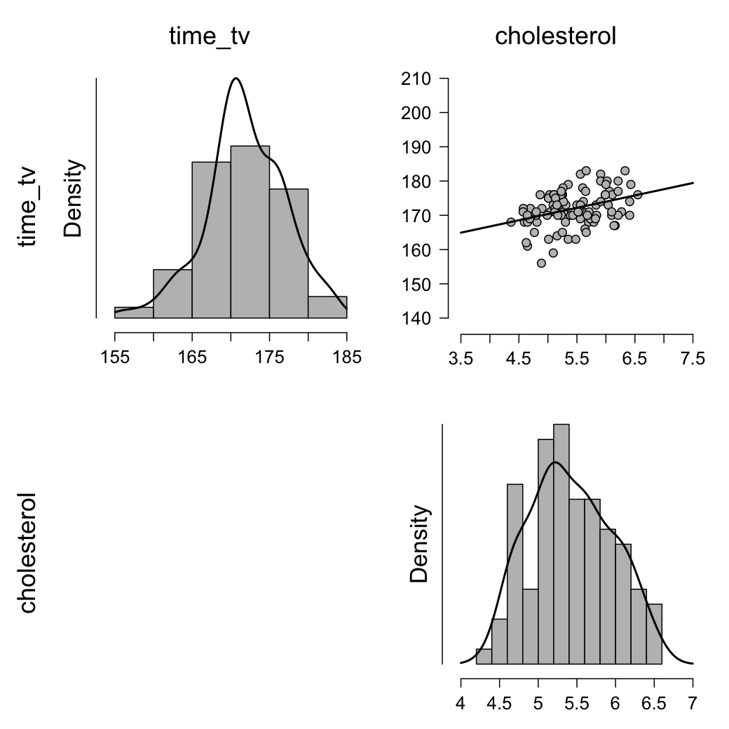
Assumptions of Data (linearity)
Open the data in JASP and make sure the variables are correct
Descriptives → Descriptive Statistics → Move both variables over to the “Variables” box → Plots → Correlation Plot
Look at top right graph
Close to a line? Linear!

Slide 9
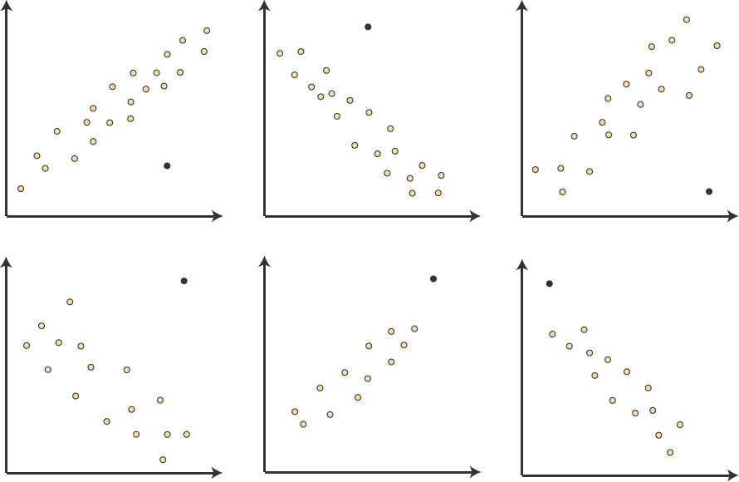
Assumptions of Data (outliers)
Look at the graph in the same graph as linearity
If data points are way off, consider them outliers see examples over here → → →
Our graph:
We don’t have anything that looks like that, so we’re good!

Slide 10
Assumptions of Residuals - Step 1
Normal distribution of residuals (normality)
Homoscedasticity of residuals (equal error variances)
Independence of residuals (independence)
*to find these we need to run part of the regression analysis

Slide 11
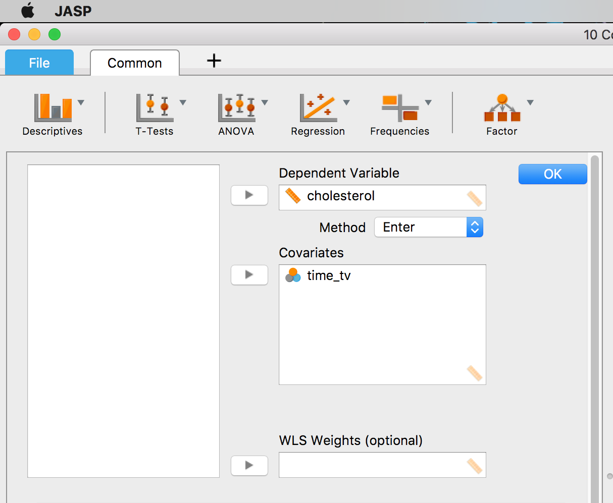
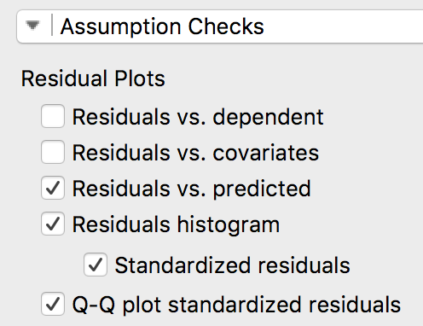
Assumptions of Residuals - Step 1
Regression → Linear Regression → move the DV to the DV box and the IV to the covariates box
Go to Assumption Checks → select: “Residuals vs. predicted,” “Residuals histogram,” “Standardized residuals,” and “Q-Q plot standardized residuals”

Slide 12
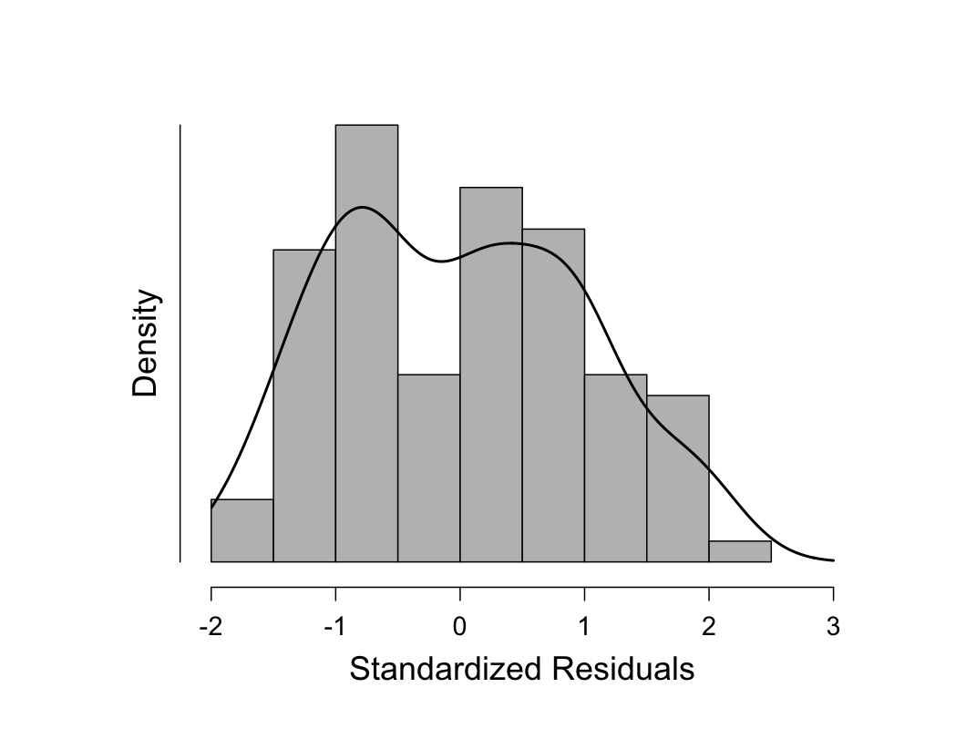
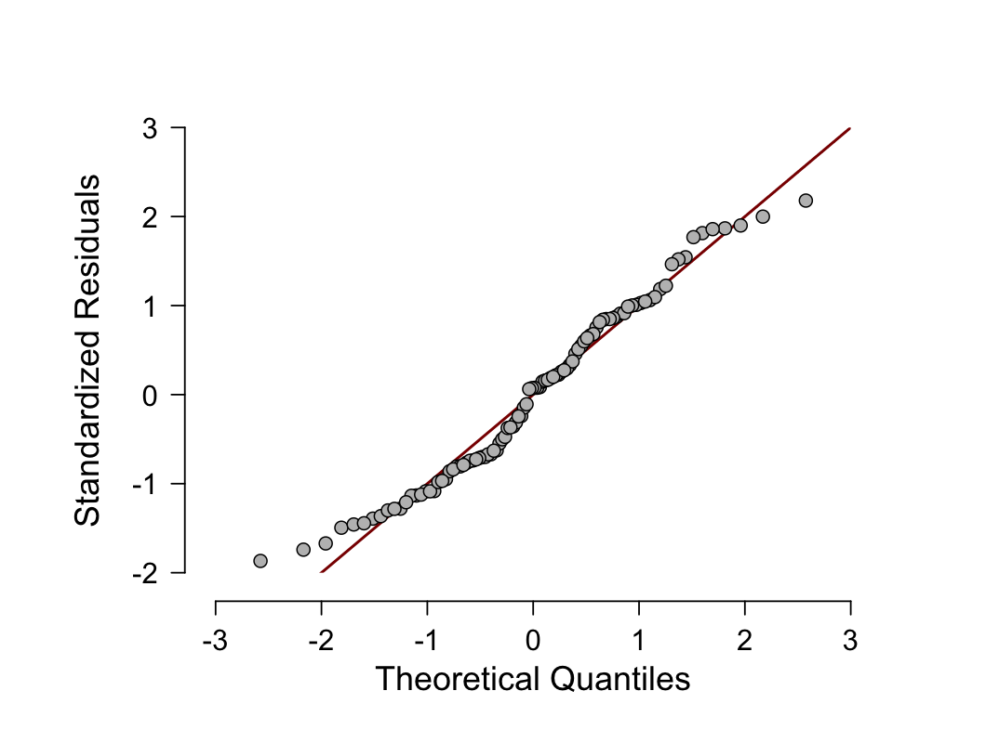
Assumptions of Residuals – (normality)
Look at the “Standardized Residuals Histogram” and the “Q-Q Plot Standardized Residuals”:
For the histogram make sure it’s approximately normal
For the Q-Q plot make sure most of the points are close to the diagonal line

Slide 13
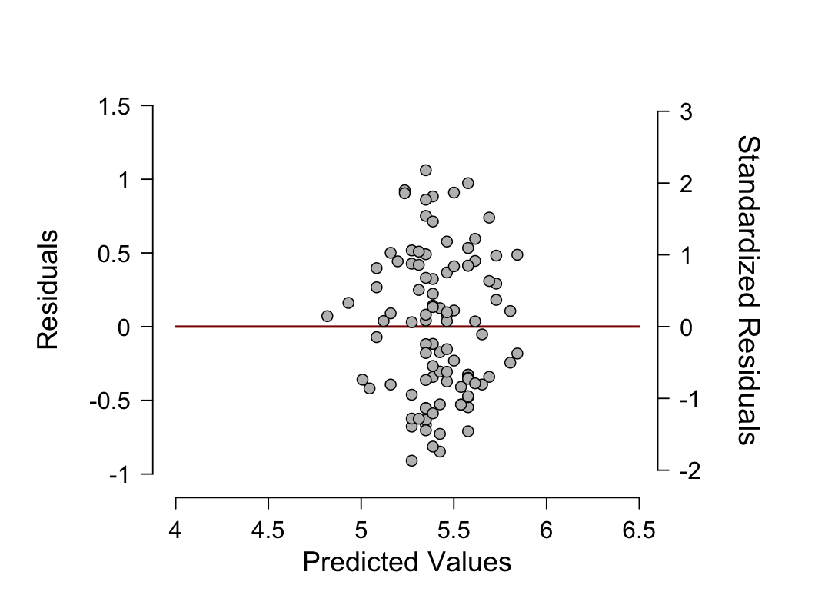
Assumptions of Residuals – (homoscedasticity)
Look at the “Residuals vs. Predicted” graph
Make sure the dots are fairly centered around zero (the line) and don’t make any crazy shapes (want to be box-like)

Slide 14
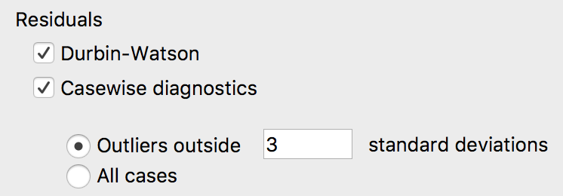
Assumptions of Residuals – (independence)
To get test this, we have to finish out the regression analysis
Go to “Statistics” → select “Durbin-Watson” and “Casewise Diagnositcs” in the Residuals section

Slide 15
Assumptions of Residuals – (independence)
Look at the “Model Summary” table that this generates in the output window and find the Dubin-Watson statistic:
This can range from 0 – 4; we want a value of about 2
A Durbin-Watson statistic close to 2 indicates no correlation between residuals
We would meet the assumption of independence of errors (residuals)!

Slide 16
Assumptions of Residuals – (outliers… again)
Can also look for outliers using casewise diagnostics
Look at the “Casewise Diagnostics” table
If there is an outlier it will be shown in the table, so we don’t have any!

Slide 17
Outlier Example
Here is what the table might look like if we did have an outlier:
How to interpret:
Case #10 is the outlier
Std. Residual is how many std. deviations this residual is from the average residual (if this # is > 3, then we would have an outlier)
“Cholesterol” is the actual cholesterol concentration value for this person
“Predicted Value” is what would be predicted by the regression
“Residual” is the difference between the actual and predicted values

Slide 18
Step 2- Sate your hypotheses
Null
No relationship between TV time and cholesterol
β₁ = 0
The coefficient of the slope equals zero
Research
Relationship between TV time and cholesterol
β₁ ≠ 0
The coefficient of the slope does not equal zero

Slide 19
Step 3- Find the regression equation and df
List regression equation
Notice relationship between β and r
Y = β₀ + β₁ * X
β₀ is the intercept (also known as the constant), β₁ is the slope parameter (also known as the slope coefficient)
Cholesterol = -1.103 + (0.038 * time_tv)
List the df
df = N – 2

Slide 20
Step 4
Find the t _{critical} value
Use the df and p critical to determine t _{critical} using the two-tailed section of the t distribution table
t _{critical} = ± 1.98

Slide 21
Step 5
List the t _{actual} (don’t use the intercept value)
t _{actual} = 3.95

Slide 22
Step 6
Reject or fail to reject
We would reject!
That means that daily time spent watching TV could statistically significantly predict cholesterol concentration

Slide 23
Understanding the Output
When you run a regression, JASP will also give you an ANOVA table
This tells you whether the regression model is a significantly better prediction of the DV than if you just used the mean
If p < .05, it is!

Slide 24
Proportionate Reduction in Error
Also called the coefficient of determination
Quantifies how much more accurate our predictions are when we use the regression line instead of the mean as a prediction tool
Explaining what R² actually means

Slide 25
Effect Size
R² = proportionate reduction in error
Same rules as ANOVA applies
Small = .01
Medium = .06
Large = .14
This effect is for ALL predictors
In this example, R² = .138, which means that the independent variable, time_tv, explains 13.8% of the variability of the dependent variable, cholesterol.

Slide 26
Putting it Together
A linear regression established that daily time spent watching TV could statistically significantly predict cholesterol concentration, F(1, 98) = 15.64, p < .001, and time spent watching TV accounted for 13.8% of the explained variability in cholesterol concentration. The regression equation was: predicted cholesterol concentration = -1.10 + 0.038 x (time spent watching tv).

Slide 27
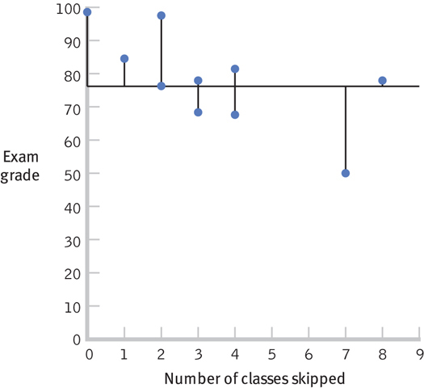
Visualizing Error

Slide 28
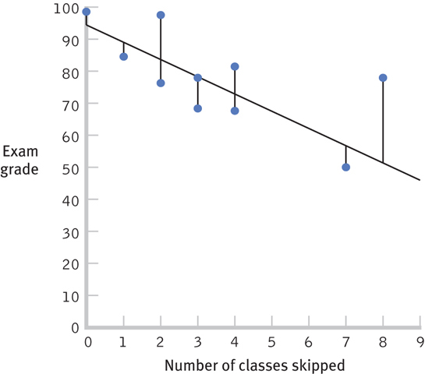
Visualizing Error

Slide 29
Regression Issues
Standard error of the estimate
Regression to the mean

Slide 30
Interpretation and Prediction
Standard error of the estimate
Indicates the typical distance between the regression line and the actual data points
Often called least squared error

Slide 31
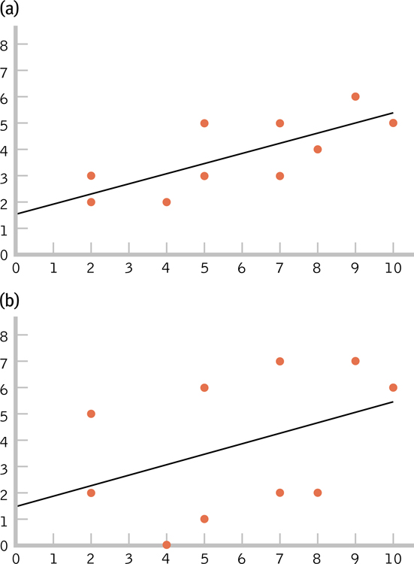
The Standard Error of the Estimate
Which figure makes the stronger prediction?
Why?

Slide 32
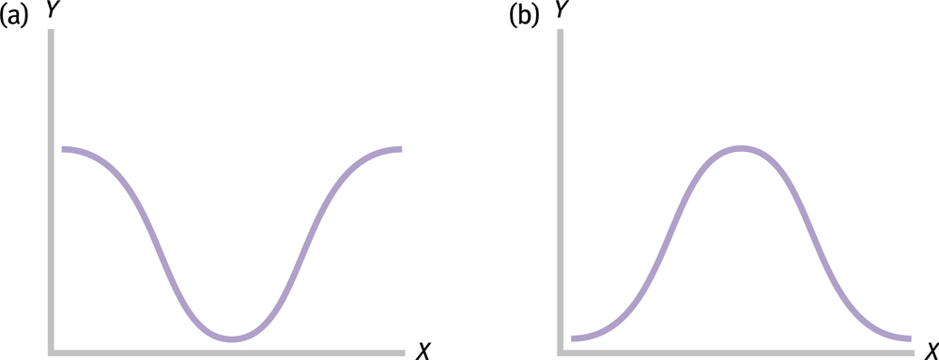
Regression to the Mean
The patterns of extreme scores

Slide 33
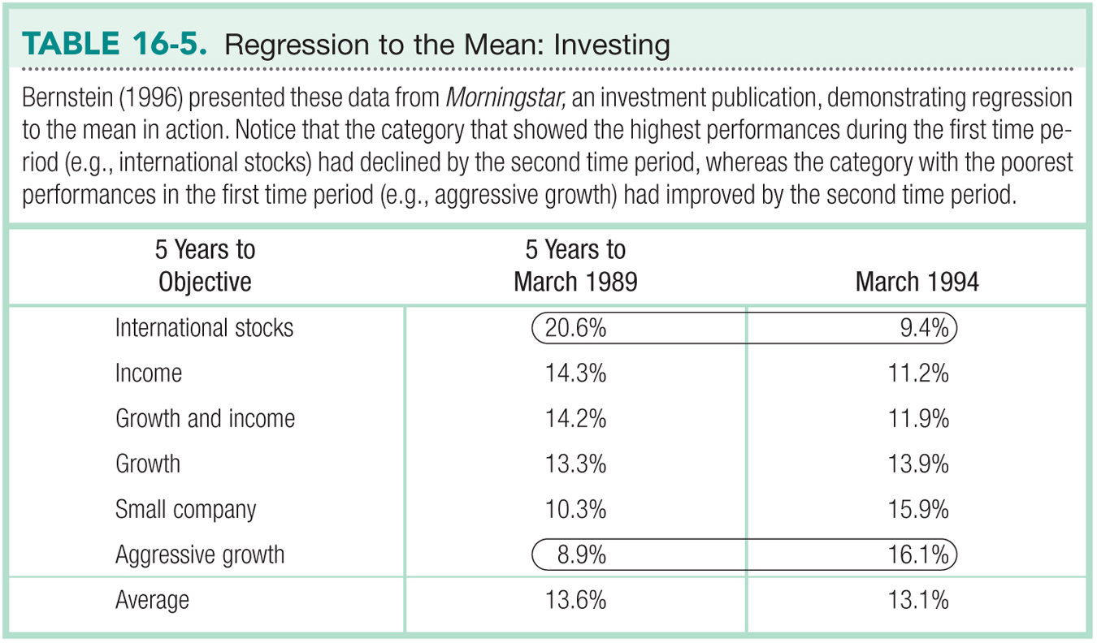

Slide 34
Other Regression Techniques
Multiple Regression
Stepwise Regression
SEM

Slide 35
Multiple Regression
A statistical technique that includes two or more predictor variables in a prediction equation

Slide 36
Stepwise Regression
A type of multiple regression in which computer software determines the order in which IVs are included in the equation
It is the default in many computer software programs
The strength of using stepwise regression is its reliance on data, rather than theory— especially when a researcher is not certain of what to expect in a study

Slide 37
Structural Equation Modeling (SEM)
A statistical technique that quantifies how well sample data “fit” a theoretical model that hypothesizes a set of relations among multiple variables
SEM encourages researchers to think of variables as a series of connections

Slide 38
